Slide 1
Landmarks of Belarus

Slide 2
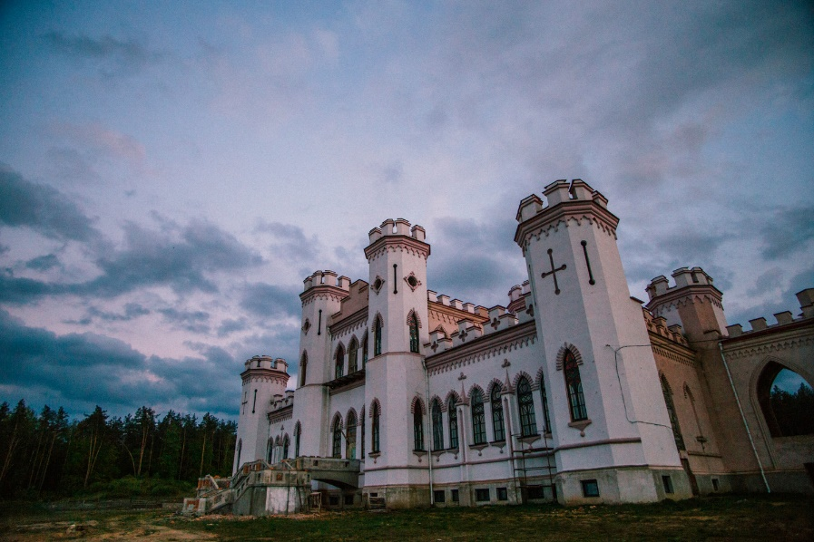
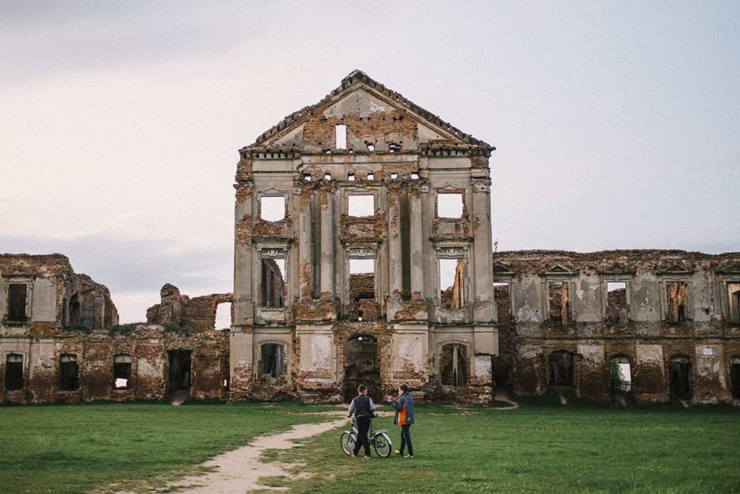
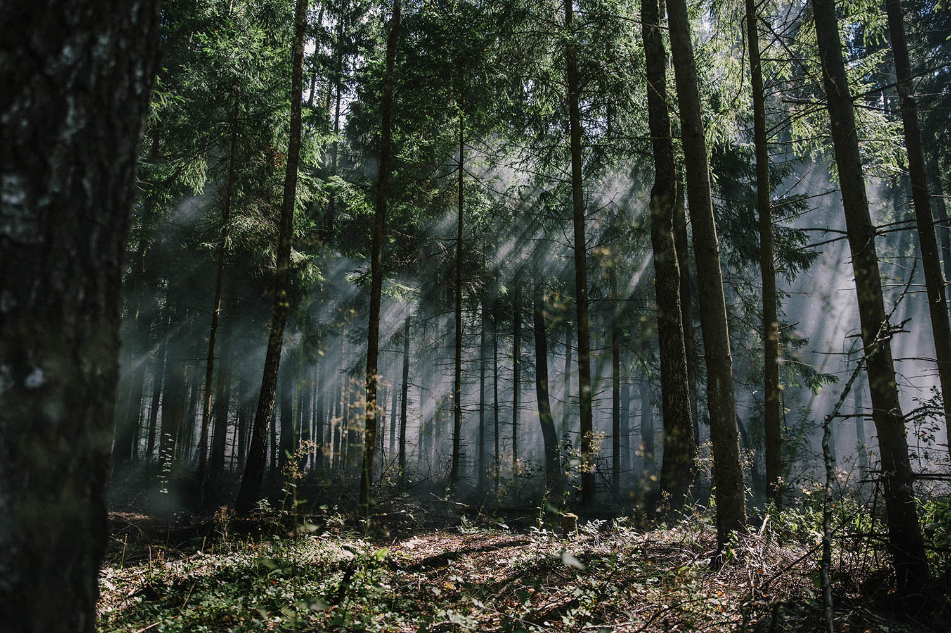
BREST REGION
The Palace Complex of the Sapegas in Ruzhany
Belovezhskaya Pushcha National park
Kosava Castle

Slide 3
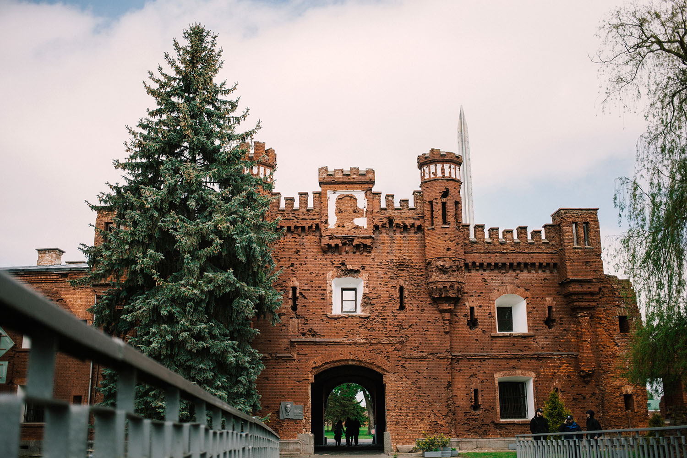
Brest Hero-Fortress

Slide 4
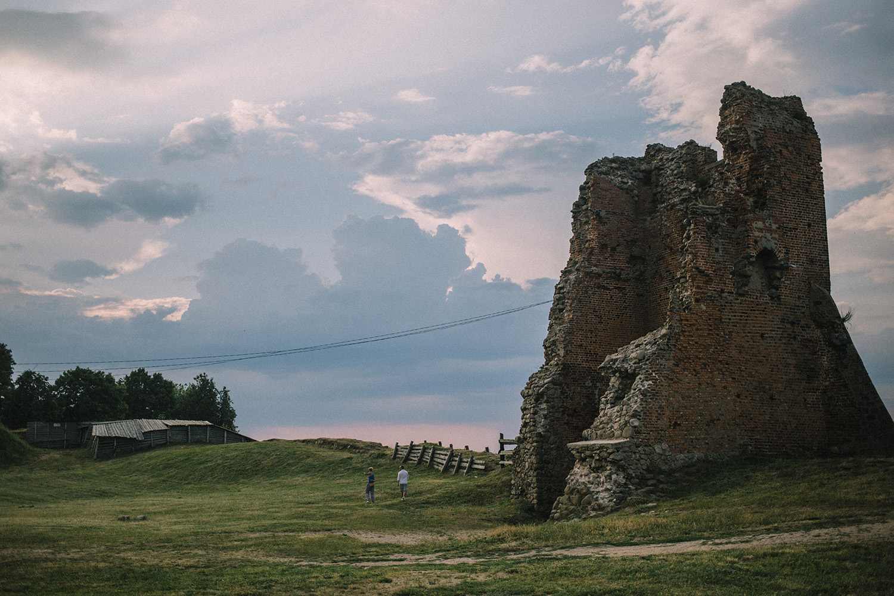
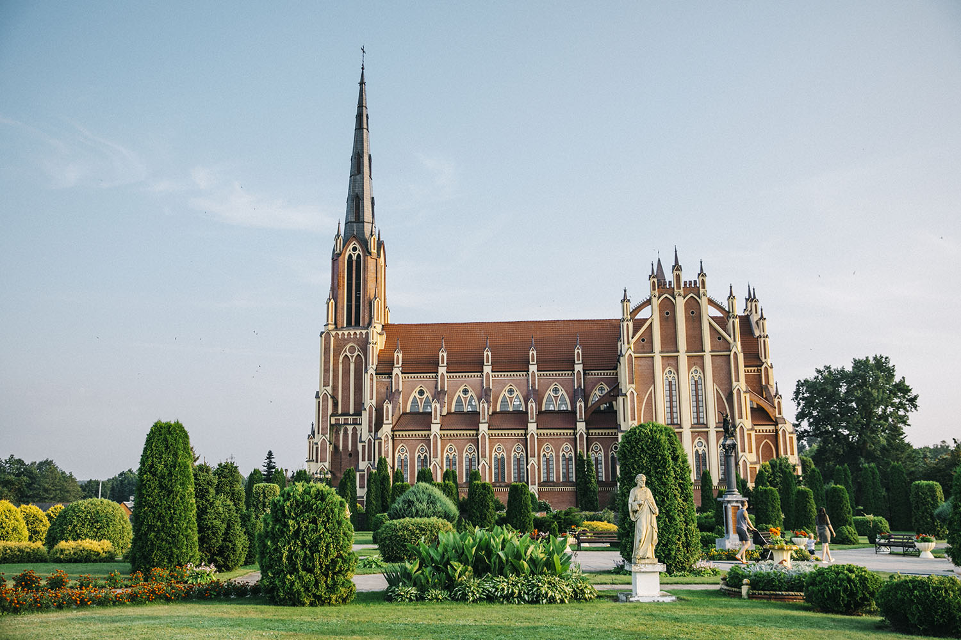
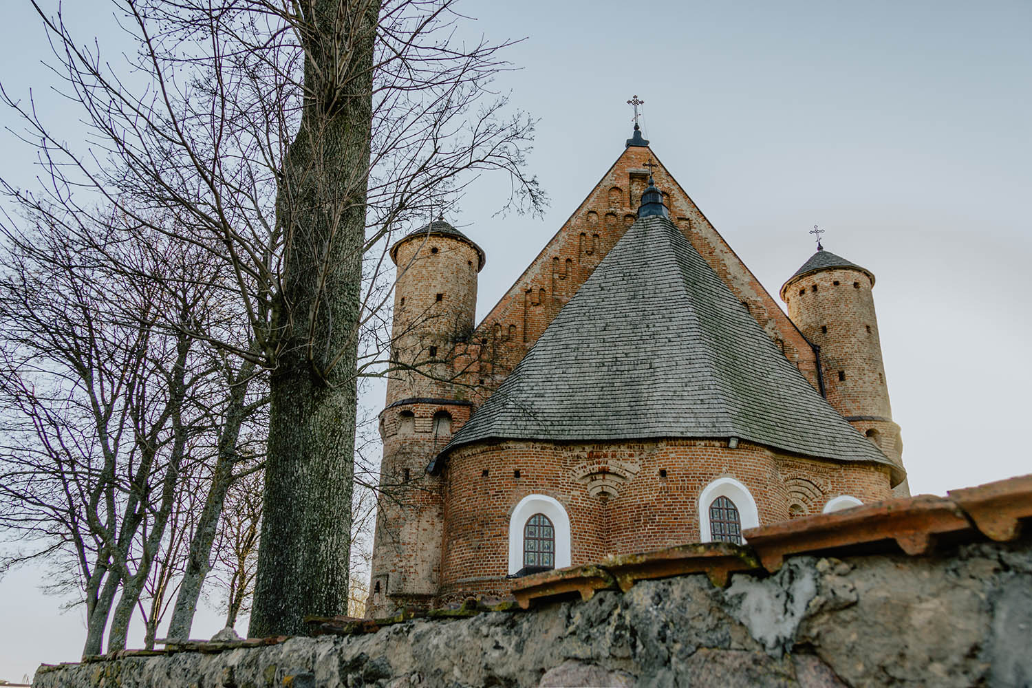
HRODNA REGION
Trinity Church in Gervyaty village
Church of Saint Michael
The castle in Navahrudak

Slide 5
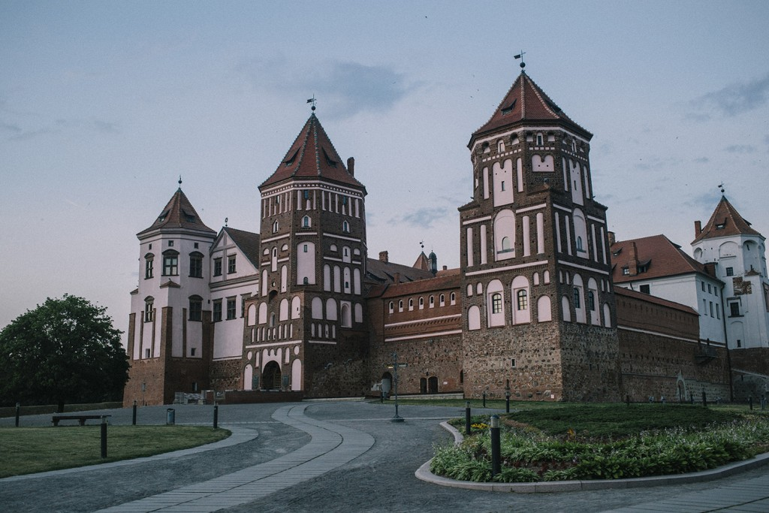
Mir Castle

Slide 6
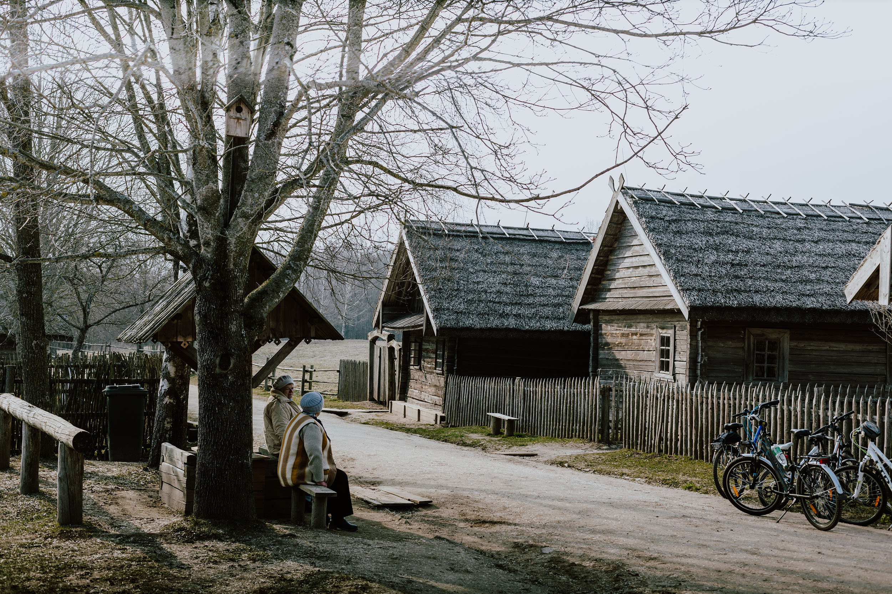
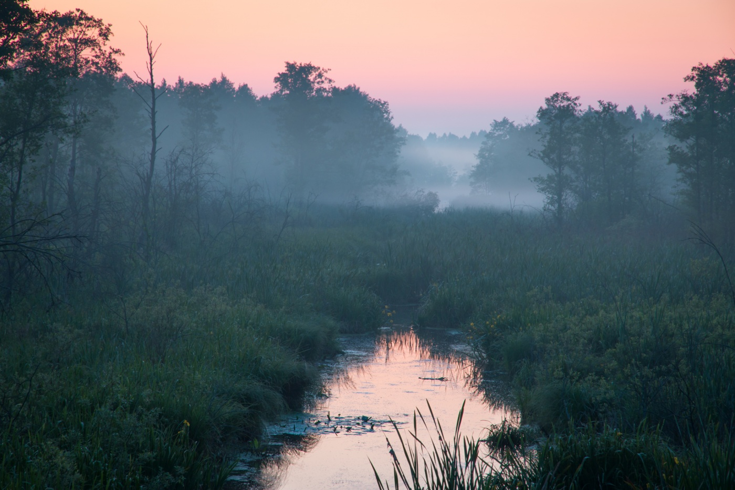
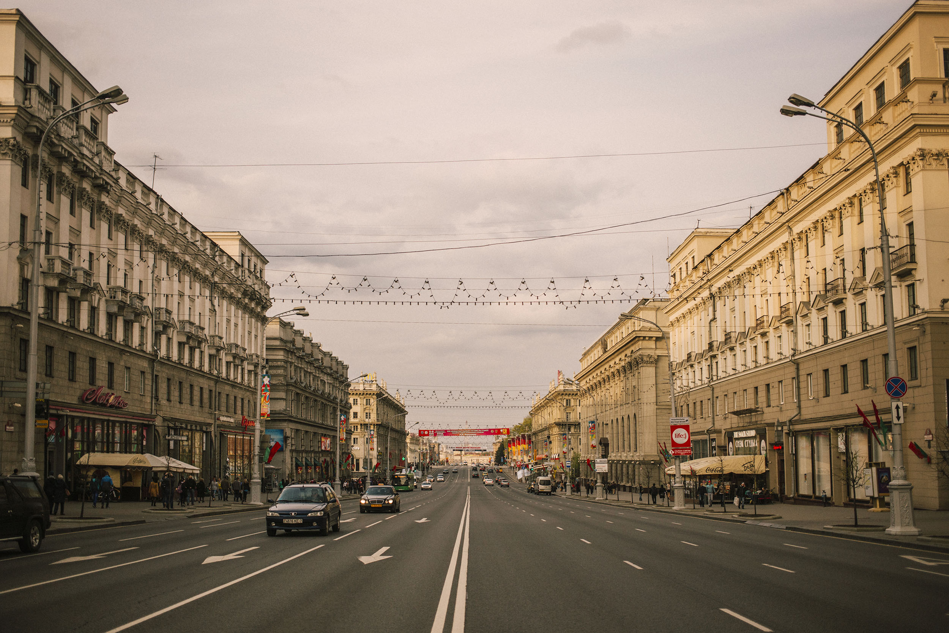
MINSK REGION
Belarusian State Museum of Folk Architecture and Rural Lifestyle
Naliboki Reserve
The City of the Sun in Minsk

Slide 7
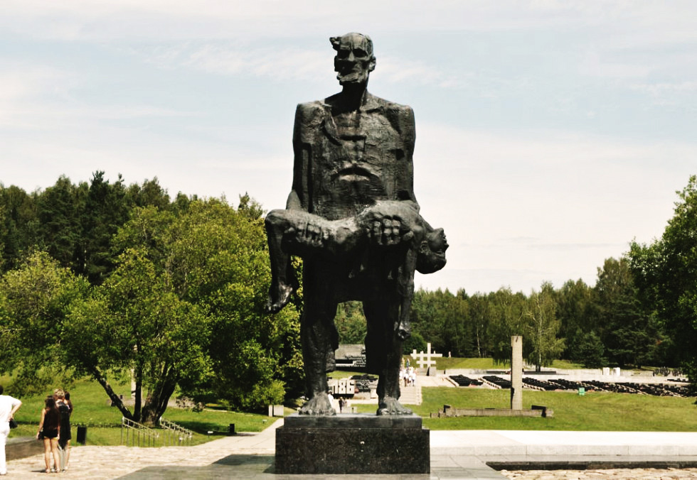
Khatyn Memorial complex

Slide 8
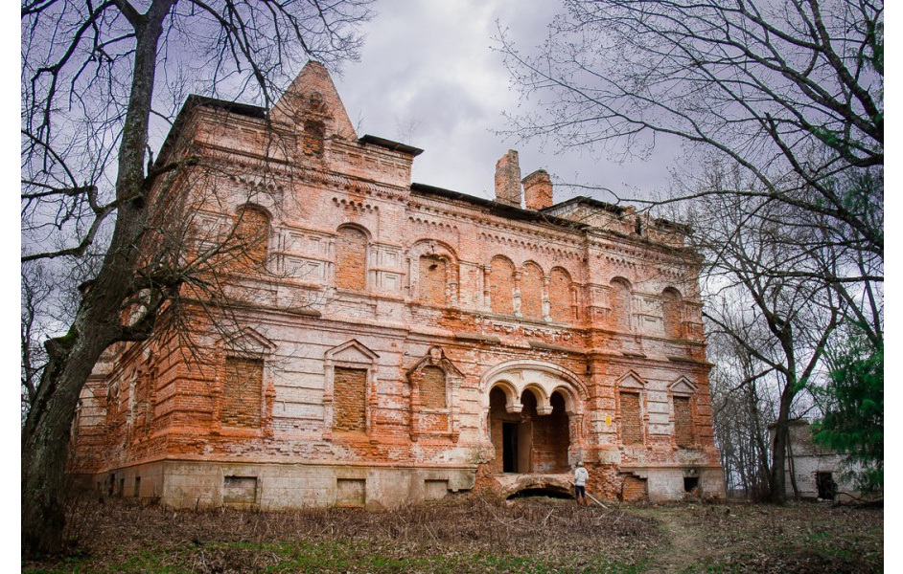
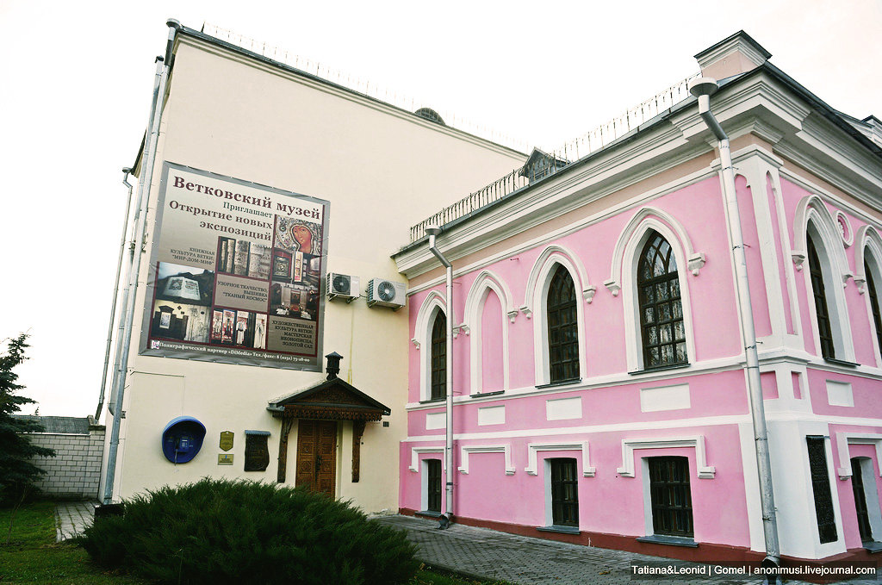
HOMIEL REGION
Gerard Manor
The Museum of Old Belief in Vietka

Slide 9
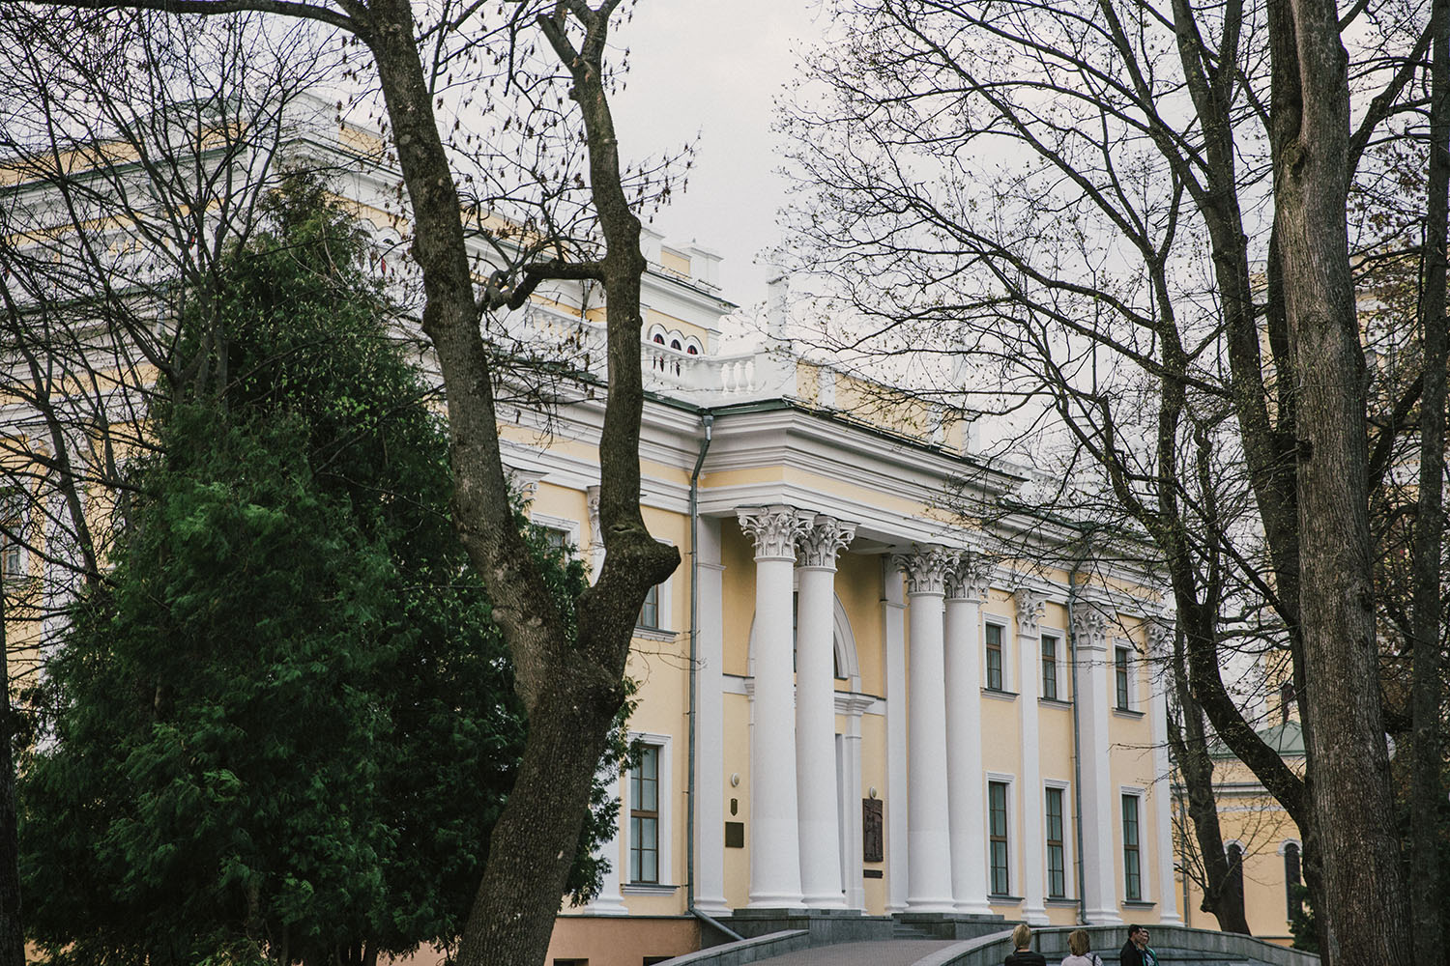
Homiel Palace and Park Ensemble

Slide 10
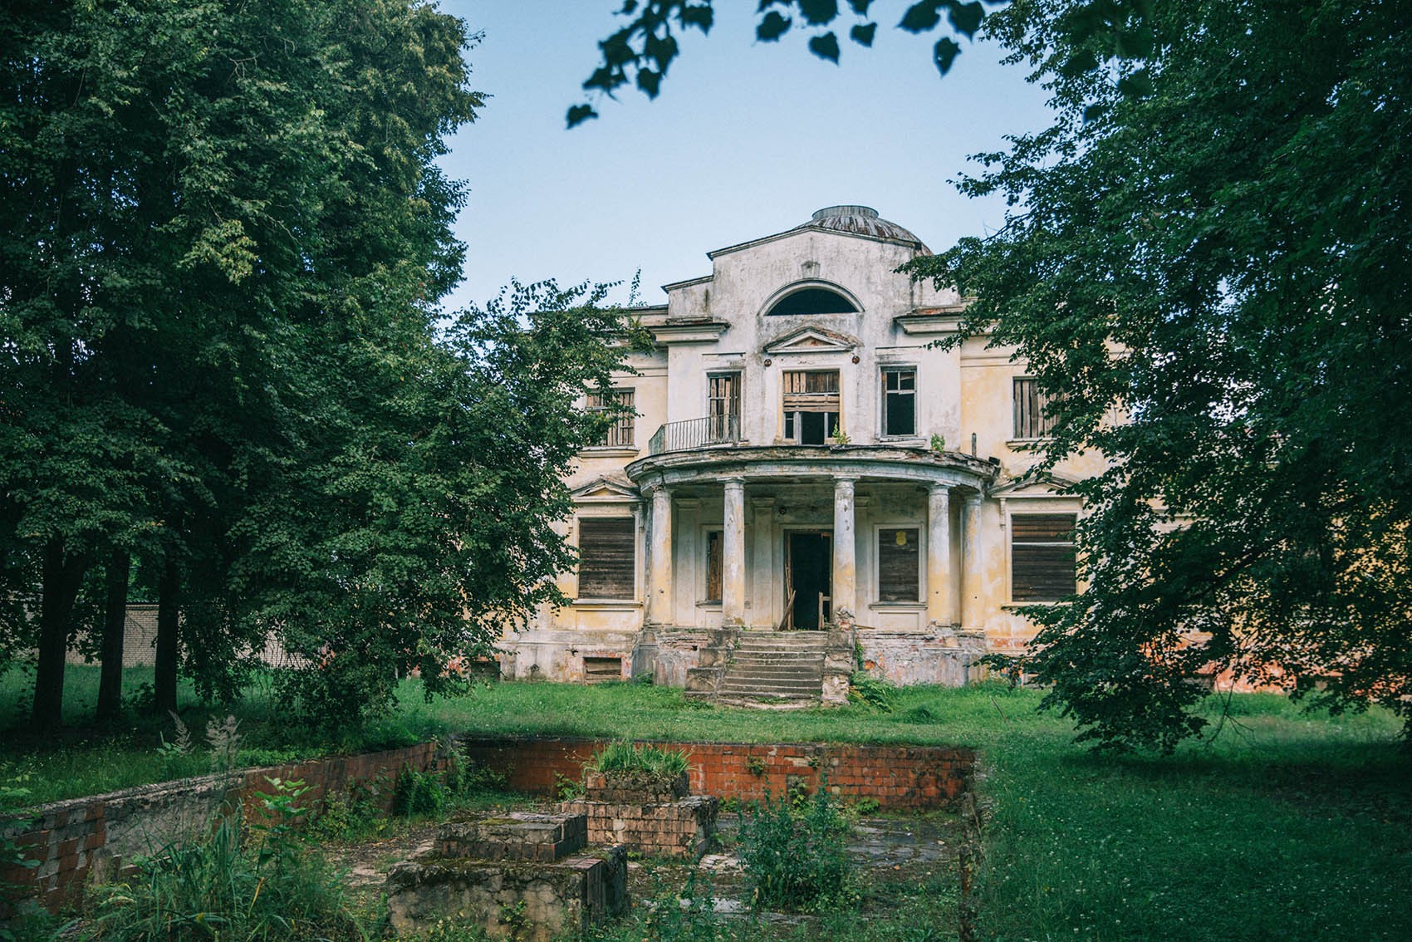
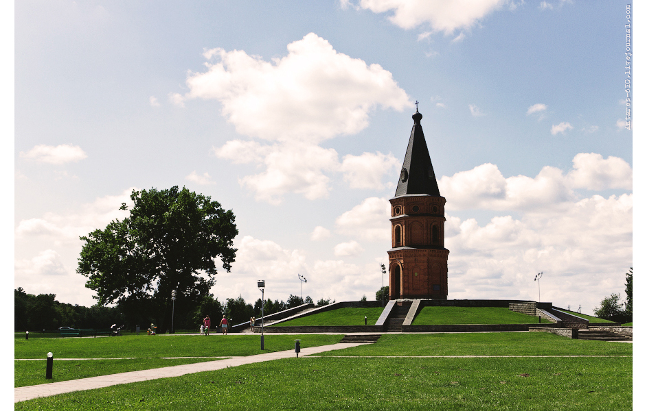
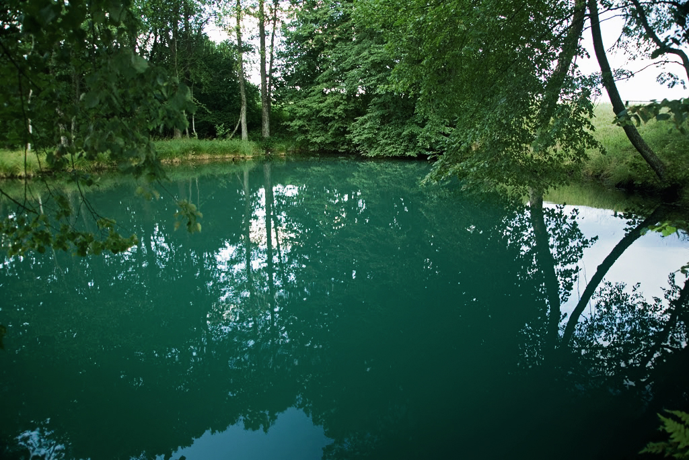
MAHILIOU REGION
Halubaya Krynitsa (Blue Spring)
Tolstoy Family Manor
Bujnichskaye Pole

Slide 11
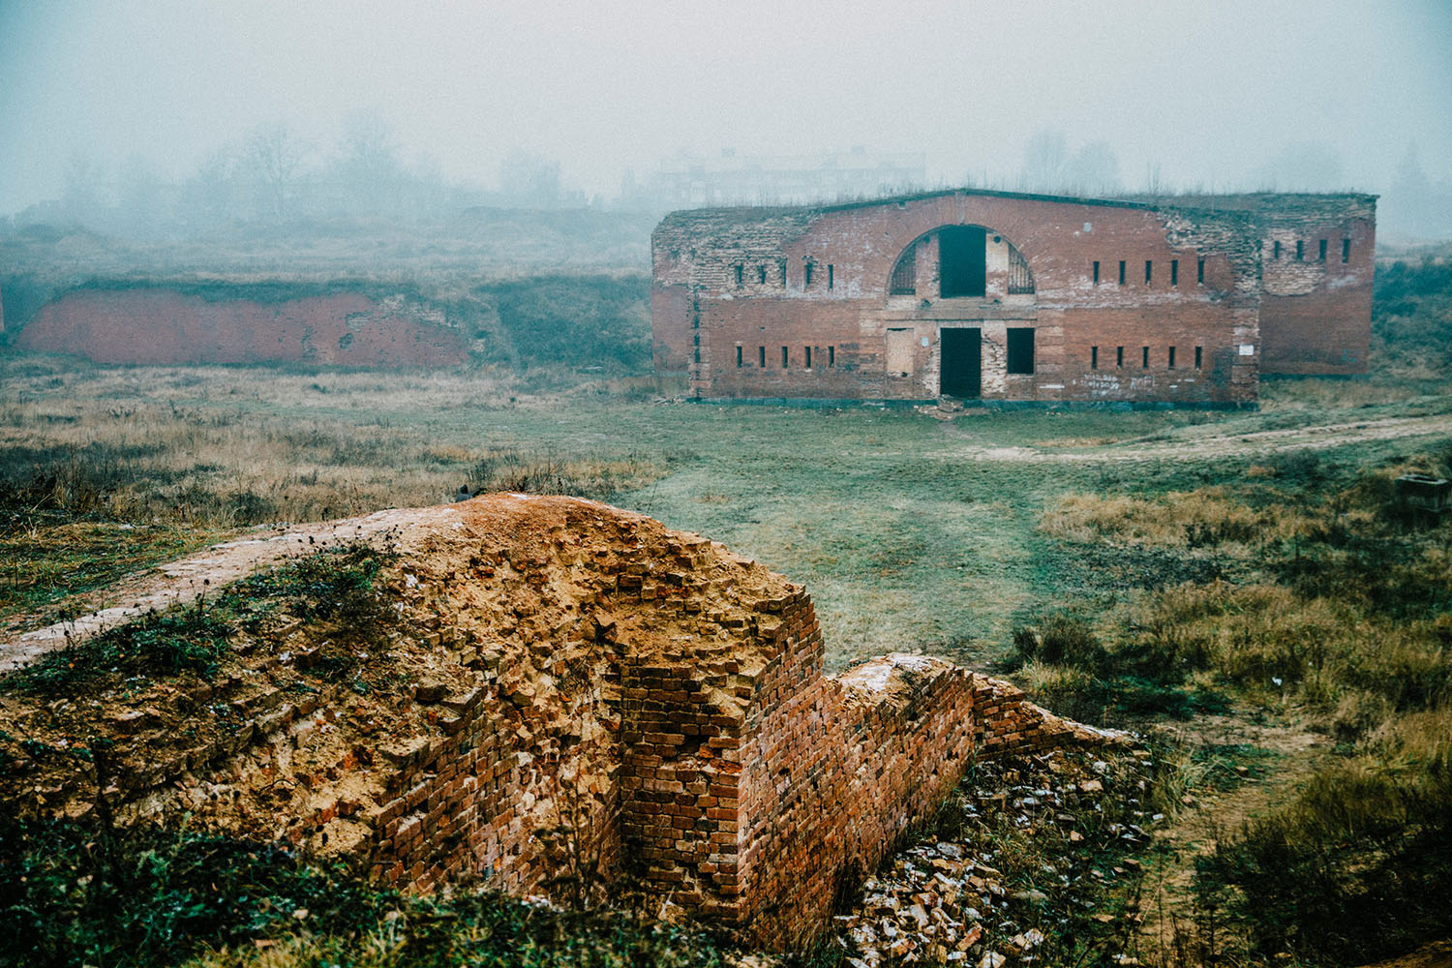
Barbujsk Fortress

Slide 12
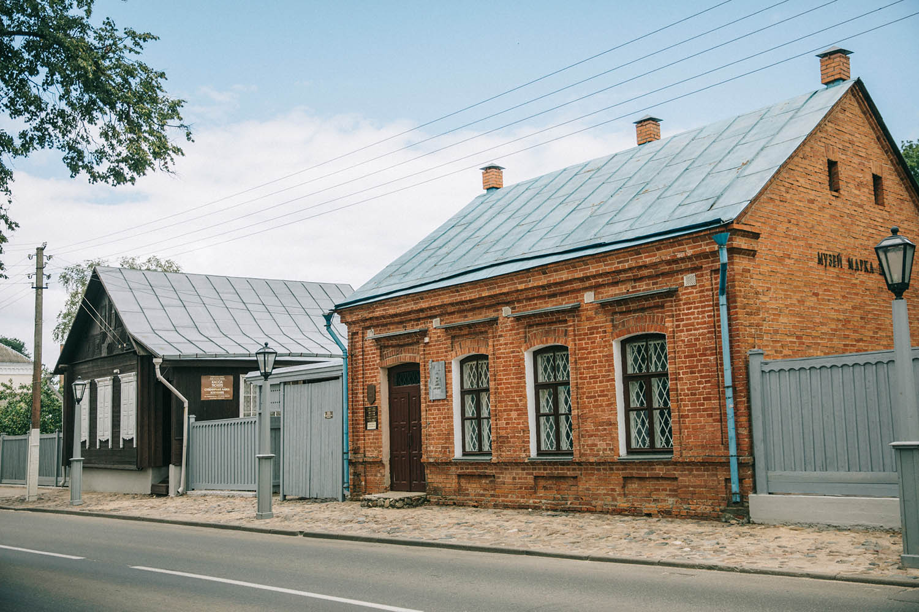
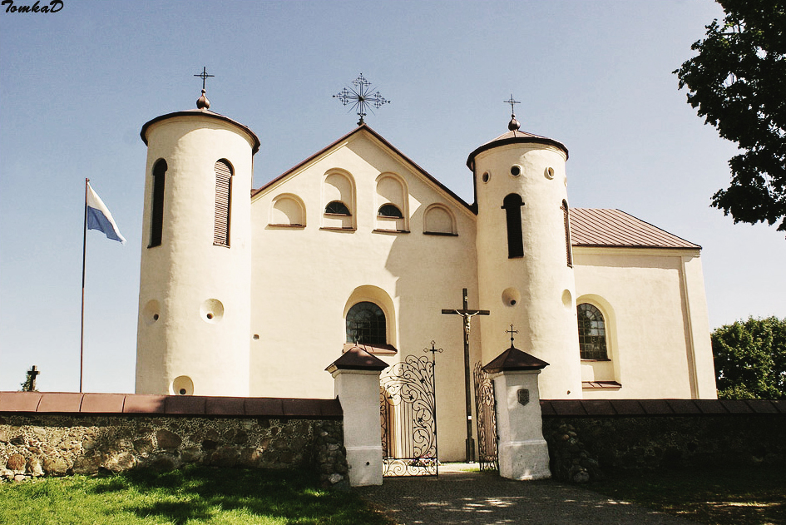
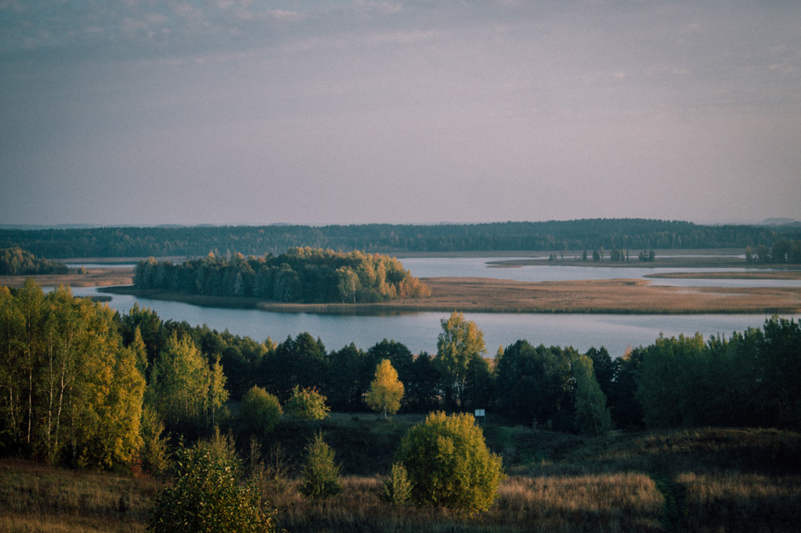
VITIEBSK REGION
Marc Chagall House Museum
St. John Baptist Church
Braslau Lakes

Slide 13
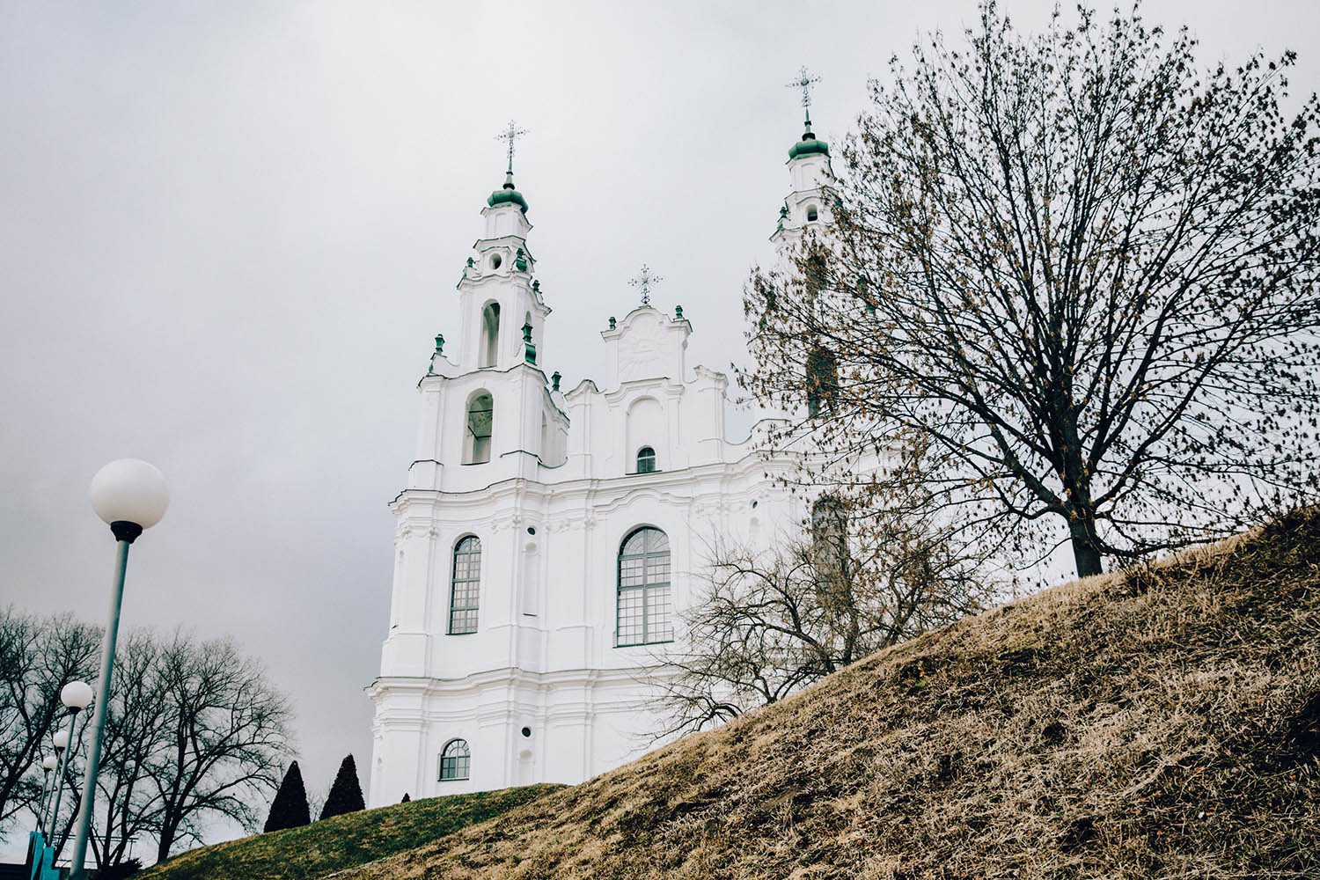
Saint Sophia Cathedral

